Slide 1
SOFTWARE ARCHITECTURE AND DESIGN
SENG 307
Module 1- Week 2
Software Architectural Structure and Views

Slide 2
Architectural Design Decisions
The seven categories of design decisions are
1. Allocation of responsibilities
2. Coordination model
3. Data model
4. Management of resources
5. Mapping among architectural elements
6. Binding time decisions
7. Choice of technology

Slide 3
Architectural Design Decisions
Architectural design decisions rely greatly on the answers to the following:
Will the system run on one processor or be distributed across multiple processors?
Will the software be layered? If so, how many layers will there be? What will each one do?
Will components communicate synchronously or asynchronously?
Will they interact by transferring control or data or both?
Will the system depend on specific features of the operating system or hardware?
Will the information that flows through the system be encrypted or not?
What operating system will we use?
What communication protocol will we choose

Slide 4
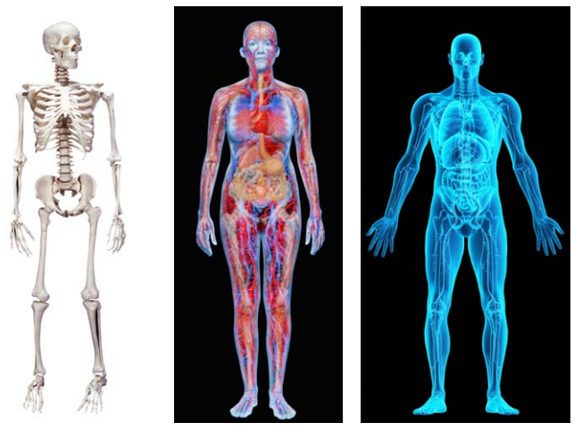
Architectural Structure and Views
Different views of the human body
Different views of the human body:
Neurologist: Brain
Orthopedist: Bones, muscles, joints & soft tissues
Hematologist: Blood cells
Dermatologist: Skin, hair and nails
views are different with very different
properties,
all are inherently related, interconnected: together
they describe the architecture of the human body.
Skeletal Vascular X-ray

Slide 5
Architectural Structure and Views
Modern systems are complex to grasp all at once.
Focus attention to one (or a small number) of the software system’s structures at a time.
That is which view we are taking of the architecture.

Slide 6
Architectural Structure and Views
A view is a representation of a coherent set of architectural elements, as written by and read by system stakeholders.
It consists of a representation of a set of elements and the relations among them.
A structure is the set of elements itself, as they exist in software or hardware
It defines the high-level organization of the system, including its components or modules and their relationships
A view is a representation of a structure
Architects design structures. They document views of those structures

Slide 7
Architectural Structure and Views
For example,
A module structure : is the set of the system’s modules and their organization.
A module view : is the representation of that structure, documented according to a template in a chosen notation, and used by some system stakeholders.

Slide 8
Three Kinds of Structures
The categories of structures correspond to the three broad kinds of decisions that architectural design involves:
Module structures
Component-and-connector structures
Allocation structures

Slide 9
Architectural Structure - Module
Embody decisions as to how the system is to be structured as a set of code or data units that have to be constructed or procured
Modules represent a static way of considering the system: there is less emphasis on how the resulting software manifests itself at runtime.
Modules are a component that is defined at the programming language level. For example, methods, classes, and packages are modules in Java.
It answer questions such as:
What is the primary functional responsibility assigned to each module?
What other software elements is a module allowed to use?
What other software does it actually use and depend on?
What modules are related to other modules by generalization or specialization (i.e., inheritance) relationships?
It is an excellent way to reason about a system’s modifiability

Slide 10
Architectural Structure – Component and Connector
Embody decisions as to how the system is to be structured as a set of elements that have runtime behavior (components) and interactions (connectors). Runtime components are principal units of computation
Connectors: are the communication vehicles among components, such as call-return, process synchronization operators, pipes, or others)
A component is any piece of software or hardware that has a clear role and can be isolated, allowing you to replace it with a different component with equivalent functionality. They are often reusable and perform a special-purpose function.
Help to answer questions such as:
What are the major executing components and how do they interact at runtime?
What are the major shared data stores?
Which parts of the system are replicated?
How does data progress through the system?
What parts of the system can run in parallel?
Can the system’s structure change as it executes and, if so, how?
Important for asking questions about the system’s runtime properties such as performance, security, availability, and more.

Slide 11
Architectural Structure – Allocation Structure
Embody decisions as to how the system will relate to non-software structures in its environment (such as CPUs, file systems, networks, development teams, etc.)
show the relationship between the software elements and elements in one or more external environments in which the software is created and executed
What processor does each software element execute on?
In what directories or files is each element stored during development, testing, and system building?
What is the assignment of each software element to development teams?

Slide 12
Software Architecture Views
A logical view, which shows the key abstractions in the system as objects or object classes. It should be possible to relate the system requirements to entities in this logical view.
A process view, which shows how, at run-time, the system is composed of interacting processes. This view is useful for making judgments about nonfunctional system characteristics such as performance and availability.
A development view, which shows how the software is decomposed for development, that is, it shows the breakdown of the software into components that are implemented by a single developer or development team. This view is useful for software managers and programmers.
A physical view, which shows the system hardware and how software components are distributed across the processors in the system. This view is useful for systems engineers planning a system deployment.

Slide 13
Some Useful Module Structures
Decomposition structure:
Shows how modules are decomposed into smaller modules recursively until
the modules are small enough to be easily understood.
Modules often have products (such as interface specifications, code, test plans, etc.)
associated with them.
Uses structure:
The units here are also modules, perhaps classes.
The units are related by the uses relation, a specialized form of dependency.
The uses structure is used to engineer systems that can be extended to add
functionality, or from which useful functional subsets can be extracted.
The ability to easily create a subset of a system allows for incremental development.

Slide 14
Some Useful Module Structures
Layer structure:
The modules in this structure are called layers.
A layer is an abstract “virtual machine” that provides a cohesive set of services through a managed interface.
Layers are allowed to use other layers in a strictly managed fashion; in strictly layered systems, a layer is only allowed to use the layer immediately below.
This structure is used to incorporate a system with portability, the ability to change the underlying computing platform.
Data model:

Slide 15
Some Useful Module Structures
Class (or generalization) structure:
The module units in this structure are called classes.
The relation is inherits from or is an instance of.
This view supports reasoning about collections of similar behavior or
capability (e.g., the classes that other classes inherit from) and
parameterized differences.
The class structure allows one to reason about reuse and the incremental
addition of functionality.

Slide 16
Some Useful C&C Structures
Service structure:
Concurrency structure:
Some Useful Allocation Structures
Deployment structure:
Implementation structure:
Work assignment structure:

Slide 17
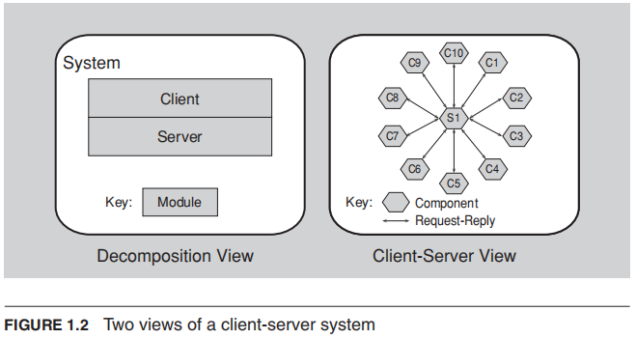
Example: Relationship of two structures to each other
The figure on the right shows a component-and-connector view of the same system.
This could be used for performance analysis, bottleneck prediction, and network traffic management, which would be extremely difficult or impossible to do with the view on the left.
The view on the left shows a module decomposition view of a tiny client-server system.
In this system, two modules must be implemented: The client software and the server software.

Slide 18
Choice of Structure
The Choice of Structure should be base on the structure that focuses more on:
the system’s most important quality attributes

